Slide 1


Good morning!
Listen to the music and answer one of the questions…
What instruments can you hear?
How does the music make you feel?
What image can you see when you hear this music?
Can you think of another piece of music like this?
Bonus questions…
Who is our focus artist this week?
Can you tell me a fact about them?

Slide 2


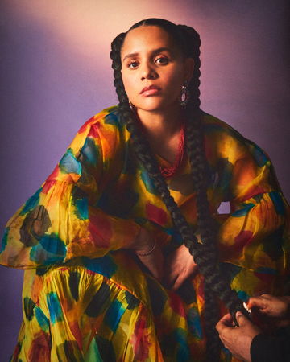


Autumn Term 1
MUSIC LISTENING JOURNEY
FOCUS GENRE = POP
IU
Korea
The Beatles
The United Kingdom
Lido Pimienta
Columbia / Canada
Vianney
France
Stevie Wonder
USA

Slide 3
🎤 IU (Lee Ji-eun)
Nationality: South Korean
Why Explore: IU is one of the most influential K-pop artists, known for her lyrical ballads and emotional storytelling. She is also admired for her charitable work and advocacy for youth mental health.
Suggested Songs: Palette, Eight
https://youtu.be/0-q1KafFCLU?si=9tJRp2gx8VyezQnz
🎤 Lido Pimienta
Nationality: Colombian-Canadian
Why Explore: Lido Pimienta uses traditional Colombian sounds (like cumbia) with electronic music to explore themes of identity, feminism, and decolonisation. She offers a unique cultural perspective rarely seen in mainstream music.
Suggested Songs: Nada, Eso Que Tú Haces
https://youtu.be/2azy1D-yyWc?si=nUs_2Qco2Yq2A_jq
🎤 Vianney
Nationality: French
Why Explore: Vianney is a singer-songwriter known for acoustic pop songs with positive, reflective lyrics. His gentle vocal style and poetic lyrics make him a good introduction to French music and language.
Suggested Songs: Je m’en vais, Beau-papa
https://youtu.be/eLYyCFuPCX8?si=fbYkKmRdYt8azA1T
🎹 Stevie Wonder
Nationality: American
Why Explore: A musical legend who began his career as a child prodigy, Stevie Wonder’s music is soulful, joyful, and empowering. He also campaigned for civil rights and disability awareness.
Suggested Songs: Superstition, Isn’t She Lovely, I Just Called to Say I Love You
https://youtu.be/hYKYka-PNt0?si=d9u_gc2fK-qtz4tL
🎸 The Beatles
Why Explore: Possibly the most influential band in modern music history, The Beatles revolutionised pop and rock. Their songs are catchy, wide-ranging in style, and great for singing and rhythm activities.
Suggested Songs: Yellow Submarine, Here Comes the Sun, All You Need Is Love
https://youtu.be/XB16AkSGLqk?si=iBVjOh2810vC7bKH

Slide 4
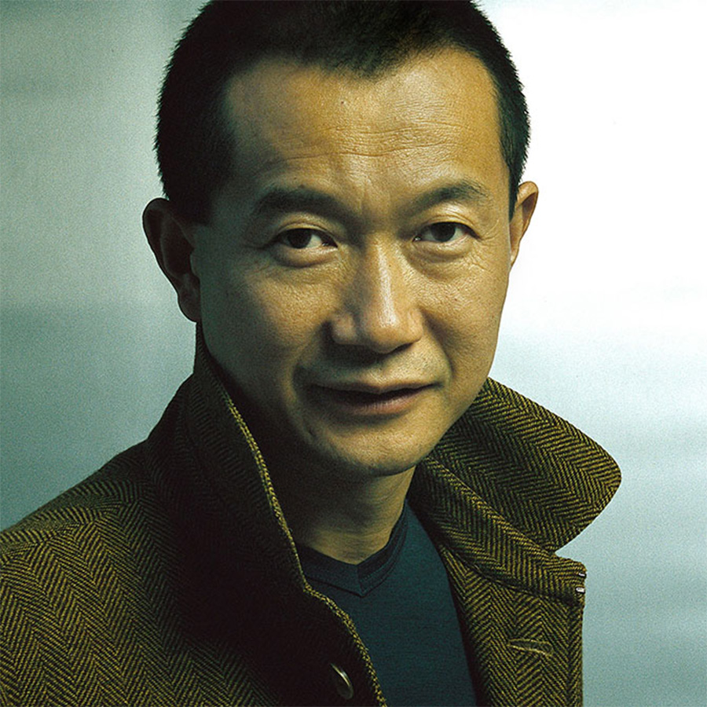
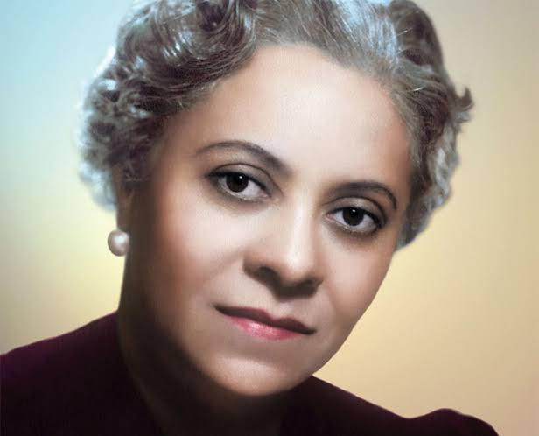
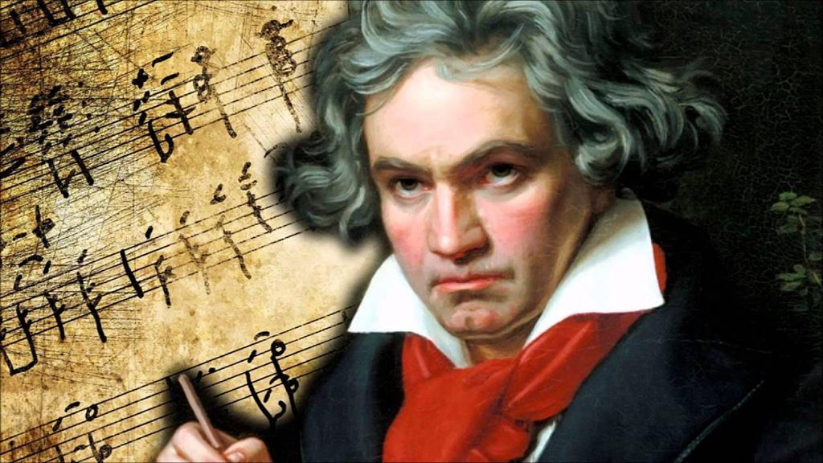
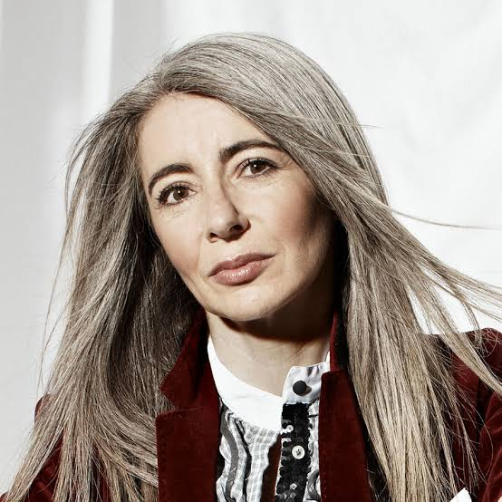

Autumn Term 2
MUSIC LISTENING JOURNEY
FOCUS GENRE = Classical
Florence Price
USA
Tan Dun
China
Ludwig van Beethoven
Germany
Evelyn Glennie
Scotland
Reena Esmail
Indian-American

Slide 5
🎻 Ludwig van Beethoven (German, Male, Disabled – hearing impairment)
One of the most famous and influential composers in history.
Ideal for teaching resilience and creativity through adversity.
Suggested Work: Symphony No. 5, Ode to Joy
https://youtu.be/W-fFHeTX70Q?si=2Yja5uT7TtK5ldrk
🎼 Florence Price (African-American, Female)
First African-American woman to have her symphony performed by a major U.S. orchestra.
A great opportunity to explore race, gender, and underrepresented voices in classical music.
Suggested Work: Symphony No. 1 in E minor, Dances in the Canebrakes
https://youtu.be/V-bLUQ2Ec9E?si=8tF0-X5T7JCDYWar
🎻 Evelyn Glennie (Scottish, Female, Disabled – profoundly deaf)
World-renowned percussionist who “hears” music through vibrations.
Brilliant role model for challenging perceptions around disability.
Suggested Work: A Little Prayer, various solo percussion works
https://youtu.be/r1r6CC7i8OY?si=papUTs3TjPWv9MZ0
🎹 Tan Dun (Chinese, Male)
Known for blending Eastern and Western classical traditions.
Composer of the Crouching Tiger, Hidden Dragon soundtrack.
Suggested Work: Water Concerto, Paper Concerto
https://youtu.be/AE2GF52g4mM?si=iPxSFXVQtEw6zoJf
🎹 Reena Esmail (Indian-American, Female)
Contemporary composer blending Indian and Western classical styles.
Promotes cultural diversity in music education.
Suggested Work: Teen Murti, Tuttarana
https://youtu.be/zaWbxeQ9jl0?si=A8qzKawmlrGCjTI1

Slide 6
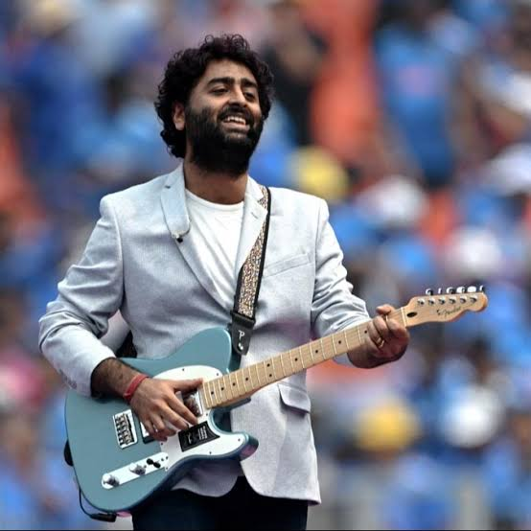
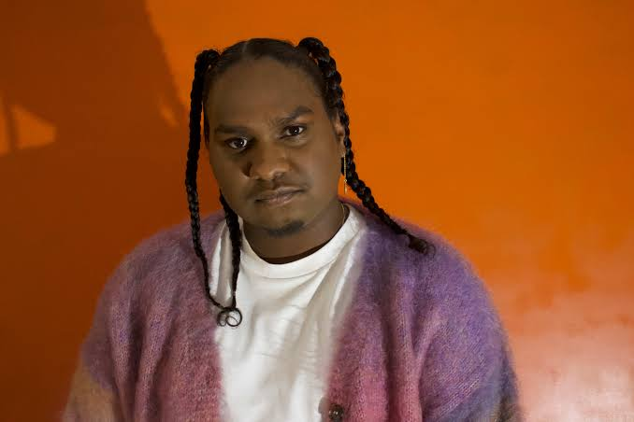
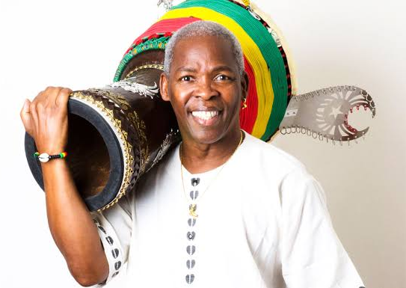


Spring Term 1
MUSIC LISTENING JOURNEY
FOCUS GENRE = Music from around the world
Arijit Singh
India – Bollywood
Baker Boy
Australia
Mamady Keïta
Guinea – Djemba Drums
Ludmilla
Brazil
S.H.E.
Taiwan

Slide 7
Artist: Mamady Keïta 🇬🇳 (Guinea)
Genre: Traditional West African Percussion (Djembe)
Why: Mamady Keïta was one of the world’s most respected djembe masters. Born in Guinea, he was a grandmaster of the Malinké drumming tradition and travelled the world teaching and performing. His work preserved and promoted djembe drumming globally, especially through his group Sewa Kan.
https://youtu.be/GkvQoG3wDPQ?si=toGZw6rKohWBByvg
🎤 Arijit Singh – Playback Singer
Genre: Romantic Ballads, Pop
Why: Arguably the most popular Bollywood singer of the last decade. Known for his emotional depth and versatility.
Suggested work: Tum Hi Ho (Aashiqui 2), Channa Mereya (Ae Dil Hai Mushkil), Kesariya (Brahmāstra)
https://youtu.be/00DvaPstcpo?si=a0fJFkrc14crpozl
🎤 Ludmilla
Genre: Funk carioca / Pop / R&B
Why: Ludmilla is a Brazilian artist who started in funk and now blends it with pop and Afro-Brazilian influences. She’s another powerful voice in Brazil’s urban music scene.
Suggested work: Socadona, Rainha da Favela, Cheguei
https://youtu.be/TxCOdjTyY94?si=A67GMTklfS0SzWj-
🎤 Baker Boy (Indigenous Australian, Male)
Hip-hop artist and dancer blending Yolŋu Matha language with contemporary rap.
Advocates for Indigenous empowerment and cultural pride.
Suggested Work: Marryuna, Meditjin
https://youtu.be/2cwoxCDY1gY?si=51U9qDuFgoHBPKN0
🎤 S.H.E (Taiwanese, Female Trio)
Mandopop pioneers known for their harmonious vocals and vibrant energy.
Blended catchy pop with heartfelt lyrics, inspiring youth empowerment and sisterhood.
Suggested Work: Super Star, 不想长大 (Don’t Want to Grow Up)
https://youtu.be/M5Y9dandexU?si=5I-LrnEQEhAM4ji5

Slide 8
Artist: Mamady Keïta (Guinea)
Genre: Traditional West African Percussion (Djembe)
Baker Boy (Indigenous Australian, Male)
Hip-hop artist and dancer blending Yolŋu Matha language with contemporary rap.
Arijit Singh – Playback Singer (India)
Genre: Romantic Ballads, Pop
Ludmilla (Brazil)
Genre: Funk carioca / Pop / R&B
S.H.E (Taiwanese, Female Trio)
Mandopop pioneers known for their harmonious vocals and vibrant energy.

Slide 9
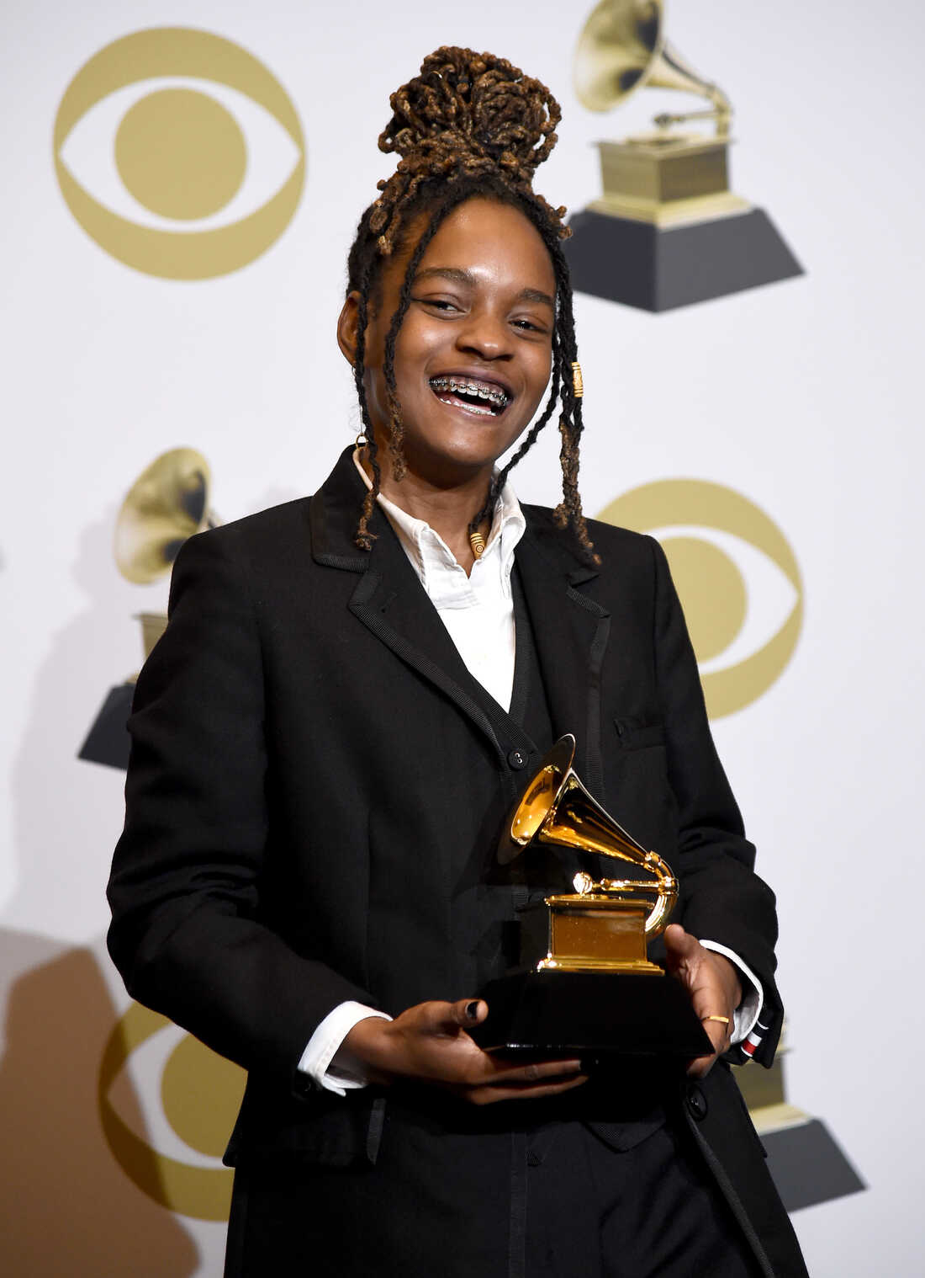


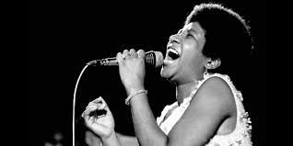

Spring Term 2
MUSIC LISTENING JOURNEY
FOCUS GENRE = Rap and RnB
Koffee
Jamaica
Run DMC
USA
MC Yogi
USA
Areatha Franklin
USA
Salt n Pepa
USA

Slide 10
🎤 MC Yogi (American, Male)
Hip-hop artist blending rap with yoga, mindfulness, and positive vibes.
Promotes kindness, self-awareness, and healthy living through music.
Suggested Work: Be the Change, Yoga Revolution
https://youtu.be/sfqkbyJSuf0?si=8-44QxGxvfMbLXJi
🎤 Koffee (Jamaican, Female)
Young reggae and rap artist known for uplifting lyrics and energetic beats.
Advocates positivity, hope, and cultural pride in her music.
Suggested Work: Toast, Rapture
https://youtu.be/i4I2Ae6FQ9g?si=mxG_VeB3sq1jTbkn
🎤 Aretha Franklin (American, Female)
The “Queen of Soul,” famous for powerful vocals and messages of empowerment.
Celebrated for themes of strength and resilience.
Suggested Work: Respect, (You Make Me Feel Like) A Natural Woman
🎤 Run-DMC (American, Male Group)
Pioneers of hip-hop with clean beats and catchy rhymes.
Helped bring rap to mainstream audiences in the 1980s.
Suggested Work: It’s Tricky, Walk This Way
https://youtu.be/l-O5IHVhWj0?si=XShW_MtjSWbuij5P
🎤 Salt-N-Pepa (American, Female Group)
Trailblazing female rap group with empowering lyrics and catchy hooks.
Known for confidence and fun energy.
Suggested Work: Push It, Shoop
https://youtu.be/RGlrcW6FzeM?si=NOSc7HV6BuTZjmSz

Slide 11


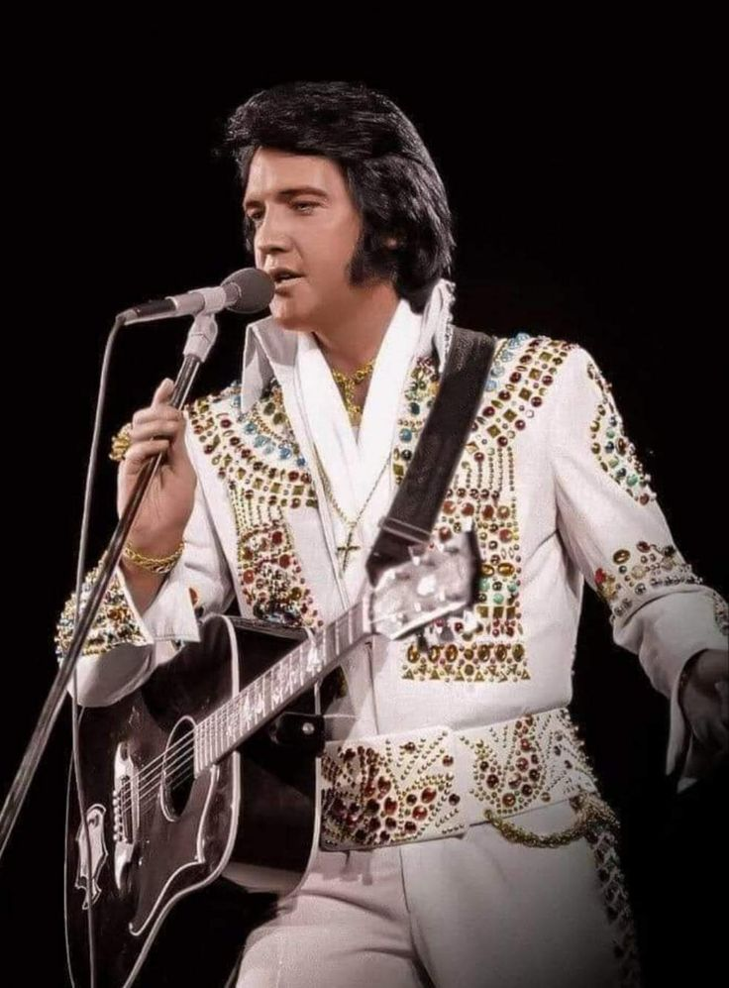

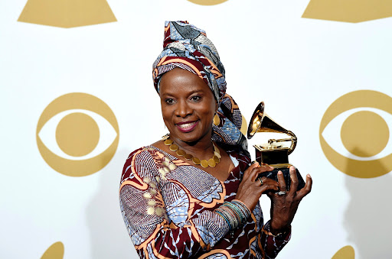
Summer Term 1
MUSIC LISTENING JOURNEY
FOCUS GENRE = Rock and Roll
Yola
UK
The Warning
Mexico
Elvis Presley
USA
X Japan
Japan
Angelique Kidjo
Beninese

Slide 12
Elvis Presley
USA
Yola
UK
🎸 Elvis Presley (American, Male Solo Artist)
The “King of Rock and Roll” who revolutionised popular music in the 1950s with his electrifying performances and unforgettable voice.
Known for energetic stage presence, genre-blending style, and iconic hits.
🎸 Yola (British, Female Solo Artist)
Genre-defying singer blending rock, soul, country, and Americana with powerful, expressive vocals.
Known for her empowering lyrics, emotional depth, and inspiring personal story.

Slide 13
X
Japan
The Warning
Mexico
🎸 The Warning (Mexican, Female Rock Band)
A powerhouse trio of sisters bringing fresh energy to modern rock with bold riffs and tight harmonies.
Known for their raw talent, strong stage presence, and inspiring rise from viral video to global tours.
🎸 X Japan (Japanese, Rock Band)
Pioneers of Japan’s visual kei movement, blending heavy rock, metal, and classical influences with dramatic flair.
Known for emotional ballads, high-energy anthems, and theatrical performances.
Suggested Work: Endless Rain, Rusty Nail

Slide 14
Angelique Kidjo
Benin
🎤 Angelique Kidjo (Beninese, Female Afrobeat Icon)
A dynamic powerhouse blending traditional African rhythms with funk, jazz, and soul, creating vibrant, global sounds.
Renowned for her electrifying vocals, passionate activism, and trailblazing role in bringing African music to worldwide audiences.

Slide 15
🎸 Elvis Presley (American, Male Solo Artist)
The “King of Rock and Roll” who revolutionised popular music in the 1950s with his electrifying performances and unforgettable voice.
Known for energetic stage presence, genre-blending style, and iconic hits.
Suggested Work: Hound Dog, Jailhouse Rock
https://youtu.be/e9BLw4W5KU8?si=7TxoCW65EXa4JOTz
🎸 Yola (British, Female Solo Artist)
Genre-defying singer blending rock, soul, country, and Americana with powerful, expressive vocals.
Known for her empowering lyrics, emotional depth, and inspiring personal story.
Suggested Work: Stand for Myself, Diamond Studded Shoes
https://youtu.be/jWTwuQ3LeH4?si=enl6xkEbA3O7WBHn
🎸 X Japan (Japanese, Rock Band)
Pioneers of Japan’s visual kei movement, blending heavy rock, metal, and classical influences with dramatic flair.
Known for emotional ballads, high-energy anthems, and theatrical performances.
Suggested Work: Endless Rain, Rusty Nail
https://youtu.be/xR-khnY4wDI?si=Qm_1YHBBLPD8uAGF
🎸 The Warning (Mexican, Female Rock Band)
A powerhouse trio of sisters bringing fresh energy to modern rock with bold riffs and tight harmonies.
Known for their raw talent, strong stage presence, and inspiring rise from viral video to global tours.
Suggested Work: Disciple
https://youtu.be/wMr1sn5iTAA?si=CragsEVLcUNYk8rM
🎤 Angelique Kidjo (Beninese, Female Afrobeat Icon)
A dynamic powerhouse blending traditional African rhythms with funk, jazz, and soul, creating vibrant, global sounds.
Renowned for her electrifying vocals, passionate activism, and trailblazing role in bringing African music to worldwide audiences.
Suggested Work: Agolo
https://youtu.be/snQ_XUMv_No?si=hbjSPKd5OujrV_52

Slide 16
Summer Term 2
MUSIC LISTENING JOURNEY
FOCUS GENRE = Chosen by the children
Artist TBC
Artist 2
Artist 4
Artist 1
Artist 3
Artist 5

