Slide 1
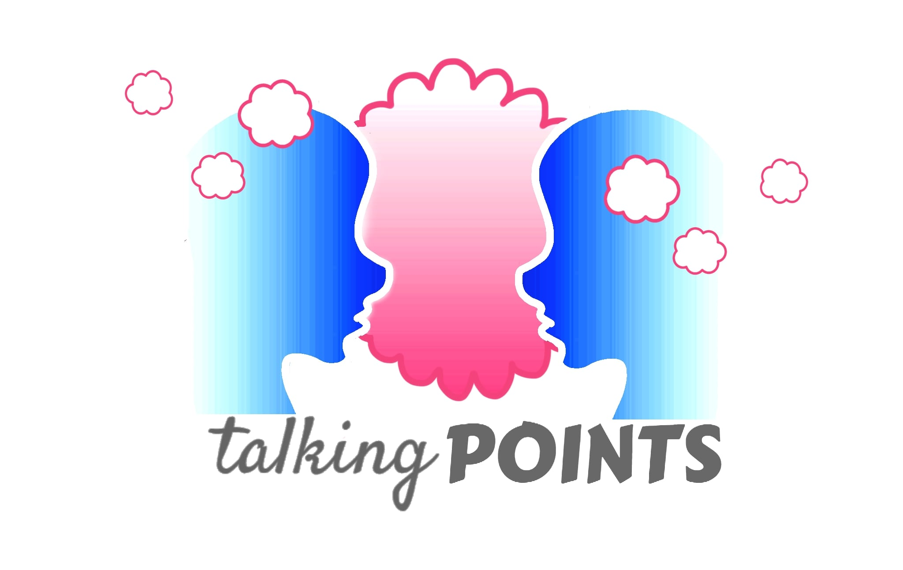
Talking Points
A Physical Health, Mental Wellbeing and Relationships Curriculum for Primary Schools - 2019

Slide 2
Coverage against DFE guidance
2019

Slide 3
Relationships Education
BP | Topic 1 - Families and people who care for me | Y1 | Y2 | Y3 | Y4 | Y5 | Y6
1 | Families are important for children growing up because they can give love, security and stability. | 1, 2 |  |  |  | 9,11 | 11
2 | Characteristics of healthy family life, commitment to each other, including in times of difficulty, protection and care for children and other family members, the importance of spending time together and sharing each others lives. | 1, 2 |  | 7, 11 |  | 9,11 | 11
3 | Others’ families, either in school or the wider world, sometimes look different from their family, but they should respect those differences and know that other children’s families are also characterised by love and care for them. | 1,2 |  | 7,161718 |  | 11 | 11

Slide 4
Relationships Education
BP | Topic 1 - Families and people who care for me | Y1 | Y2 | Y3 | Y4 | Y5 | Y6
4 | Stable, caring relationships, which may be of different types, are at the heart of happy families, and are important for children’s security as they grow up. | 1,2 |  | 1117 18 |  | 11 | 11
5 | Marriage represents a formal and legally recognised commitment of two people to each other which is intended to be lifelong. |  |  |  |  | 11
6 | Recognise if family relationships are making them feel unhappy or unsafe, and how to seek help or advice from others if needed. | 2 |  | 1214 |  | 2 | 9

Slide 5
Relationships Education
BP | Topic 2 - Caring friendships | Y1 | Y2 | Y3 | Y4 | Y5 | Y6
1 | How important friendships are in making us feel happy and secure, and how people choose and make friends. |  |  | 6, 9 | 3 | 7,10 | 6,8
2 | Characteristics of friendships, including mutual respect, truthfulness, trustworthiness, loyalty, trust, sharing interests and experiences and support with problems and difficulties. | 2 | 10 | 6, 7, 9, 1013 | 3 | 7,10 | 6,8,17
3 | Healthy friendships are positive and welcoming towards others, and do not make others feel lonely or excluded. | 7, 18 | 8 | 11,12 | 3 | 7,13 | 6,8

Slide 6
Relationships Education
BP | Topic 2 - Caring friendships | Y1 | Y2 | Y3 | Y4 | Y5 | Y6
4 | Most friendships have ups and downs, and that these can often be worked through so that the friendship is repaired or even strengthened, and that resorting to violence is never right. | 7, 18 | 8 | 6, 8,1213 | 2,3 |  | 15
5 | Recognise who to trust and who not to trust, how to judge when a friendship is making them feel unhappy or uncomfortable, how to manage these situations and how to seek help and advice from others, if needed. | 2, 8 |  | 9,11,1214 | 2 | 7,10 14 | 6,7,8,9,17

Slide 7
Relationships Education
BP | Topic 3 - Respectful relationships | Y1 | Y2 | Y3 | Y4 | Y5 | Y6
1 | Importance of respecting others, even when they are very different from them, or make different choices or have different preferences or beliefs. | 3 | 8, 9 | 6, 7 | 3,1415 | 7,8 13 14 | 15
2 | Practical steps they can take in a range of different contexts to improve or support respectful relationships | 3 | 6,7 | 6 | 3 |  | 7,15
3 | Conventions of courtesy and manners. | 3 | 7 | 6, 9 | 9,10
4 | Importance of self-respect and how this links to their own happiness. |  | 10 | 7,16 | 15 | 12 | 6,8

Slide 8
Relationships Education
BP | Topic 3 - Respectful relationships | Y1 | Y2 | Y3 | Y4 | Y5 | Y6
5 | In school and in wider society they can expect to be treated with respect by others, and that in turn they should show due respect to others, including those in positions of authority. | 3,8 | 9 | 7, 8, 9,10 | 9,101415 | 7,10 12 | 6
6 | About different types of bullying (including cyberbullying), the impact of bullying, responsibilities of bystanders (reporting bullying to an adult) and how to get help. |  |  | 121416 | 14 | 7,8,10 14 | 6,7,8,17
7 | What a stereotype is, and how stereotypes can be unfair, negative or destructive. |  |  | 16 | 14 | 1213 14
8 | The importance of permission-seeking and giving in relationships with friends, peers and adults. | 9 | 14 |  | 10 | 10 | 7

Slide 9
Relationships Education
BP | Topic 4 – Online relationships | Y1 | Y2 | Y3 | Y4 | Y5 | Y6
1 | People sometimes behave differently online, including by pretending to be someone they are not. |  |  |  | 6 |  | 7
2 | The same principles apply to online relationships as to face to face relationships, including the importance of respect for others online including when we are anonymous. |  |  |  | 6,7 |  | 7,151617
3 | Rules and principles for keeping safe online, how to recognise risks, harmful content and contact, and how to report them |  | 17 | 14 | 6 |  | 7,1617

Slide 10
Relationships Education
BP | Topic 4 – Online relationships | Y1 | Y2 | Y3 | Y4 | Y5 | Y6
4 | To critically consider their online friendships and sources of information including awareness of the risks associated with people they have never met. |  |  |  | 6 |  | 7,1617
5 | How information and data is shared and used online. |  | 17 |  |  |  | 7

Slide 11
Relationships Education
BP | Topic 5 – Being safe | Y1 | Y2 | Y3 | Y4 | Y5 | Y6
1 | Sorts of boundaries that are appropriate in friendships with peers and others (including in a digital context). | 8, 9 | 14 |  | 2,6,7 | 10
2 | The concept of privacy and the implications of it for both children and adults; including that it is not always right to keep secrets if they relate to being safe. | 9 | 14 16 |  |  |  | 9
3 | Each person’s body belongs to them, and the differences between appropriate and inappropriate or unsafe physical, and other, contact. | 9 | 14 | 11 |  |  | 9
4 | How to respond safely and appropriately to adults they may encounter that they do not know. |  | 15 | 5

Slide 12
Relationships Education
BP | Topic 5 – Being safe | Y1 | Y2 | Y3 | Y4 | Y5 | Y6
5 | How to recognise and report feelings of being unsafe or feeling bad about any adult. |  | 14 |  |  | 8 | 9
6 | To ask for advice or help for self or for others, and to keep trying until they are heard. |  | 14 16 | 14 | 7 | 7,8,10 14 | 9,16
7 | How to report concerns or abuse, and the vocabulary and confidence to do so. |  | 14 |  |  | 8 | 9,16
8 | Where to get advice from e.g. family, school and/or other sources. |  | 14 16 | 14 | 7 | 10 | 9,16

Slide 13
Physical health and mental wellbeing education
BP | Topic 1 – Mental wellbeing | Y1 | Y2 | Y3 | Y4 | Y5 | Y6
1 | Mental wellbeing is a normal part of daily life, in the same way as physical health. |  |  | 1, 2 | 8 | 3 | 3
2 | There is a normal range of emotions (e.g. happiness, sadness, anger, fear, surprise, nervousness) and scale of emotions that all humans experience in relation to different experiences and situations. | 4, 5, 10 | 5 | 8 | 1,2,13 | 9 | 4
3 | To recognise and talk about their emotions, including having a varied vocabulary of words to use when talking about their own and others’ feelings. | 4, 5, 10 | 5 |  | 1,2,8 | 3,9 | 4
4 | To judge whether what they are feeling and how they are behaving is appropriate and proportionate. | 5 | 5, 6 |  | 1,2,5 | 3.9

Slide 14
Physical health and mental wellbeing education
BP | Topic 1 – Mental wellbeing | Y1 | Y2 | Y3 | Y4 | Y5 | Y6
5 | Benefits of physical exercise, time outdoors, community participation, voluntary and service based activity on mental wellbeing and happiness. | 4, 5 | 5 | 1 | 161718 |  | 3
6 | Simple self-care techniques, including the impact of relaxation, time spent with friends and family and the benefits of hobbies and interests. | 4, 5 | 5 | 2 | 8 | 3 | 3,4
7 | Isolation and loneliness can affect children and that it is very important for children to discuss their feelings with an adult and seek support. | 4, 5, 10 |  |  | 1,8 | 3.9 10 | 3
8 | Bullying (including cyberbullying) has a negative and often lasting impact on mental wellbeing. |  |  |  |  | 7 | 3

Slide 15
Physical health and mental wellbeing education
BP | Topic 1 – Mental wellbeing | Y1 | Y2 | Y3 | Y4 | Y5 | Y6
9 | Where and how to seek support (including the triggers for support), including whom in school they should speak to if they are worried about their own or someone else’s mental wellbeing or ability to control their emotions (including issues arising online). | 5, 10 |  |  | 2,8.13 | 3,9 | 3,4
10 | It is common for people to experience mental ill health. For many people who do, the problems can resolve if the right support is made available and accessed, especially if they access support as early as possible. |  |  | 1 | 8 | 3,9 | 3

Slide 16
Physical health and mental wellbeing education
BP | Topic 2 – Internet safety and harms | Y1 | Y2 | Y3 | Y4 | Y5 | Y6
1 | For most people, the internet is an integral part of life and has many benefits. |  | 17 |  |  |  | 13
2 | The benefits of rationing time spent online, the risks of excessive time spent on electronic devices and the impact of positive and negative content online on their own and others’ mental wellbeing. |  | 17 |  |  |  | 5
3 | Consider the effect of their online actions on others and know how to recognise and display respectful behaviour online. |  | 17 |  |  |  | 1617

Slide 17
Physical health and mental wellbeing education
BP | Topic 2 – Internet safety and harms | Y1 | Y2 | Y3 | Y4 | Y5 | Y6
4 | Why social media, some computer games and online gaming, for example, are age restricted. |  | 17 |  |  |  | 5
5 | The internet can also be a negative place where online abuse, trolling, bullying and harassment can take place, which can have a negative impact on mental health. |  | 17 |  |  |  | 7,1317
6 | How to be a discerning consumer of information online including understanding that information, including that from search engines is ranked, selected and targeted. |  |  |  |  |  | 1314
7 | Where and how to report concerns and get support with issues online |  |  |  |  |  | 7,1314

Slide 18
Physical health and mental wellbeing education
BP | Topic 3 – Physical health and fitness | Y1 | Y2 | Y3 | Y4 | Y5 | Y6
1 | Characteristics and mental and physical benefits of an active lifestyle. |  | 1 | 1, 2 |  |  | 3,12
2 | Importance of building regular exercise into daily and weekly routines. How to achieve this, for example a daily mile or other forms of regular, vigorous exercise. |  | 1 | 1, 2 |  |  | 12
3 | Risks associated with an inactive lifestyle (including obesity). |  | 1 | 1, 2 |  |  | 12
4 | How and when to seek support including which adults to speak to in school if they are worried about their health |  |  | 1, 2 |  |  | 12

Slide 19
Physical health and mental wellbeing education
BP | Topic 4 – Healthy eating | Y1 | Y2 | Y3 | Y4 | Y5 | Y6
1 | What constitutes a healthy diet (including understanding calories and nutritional content). |  | 2 | 1 |  |  | 12
2 | Principles of planning and preparing a range of healthy meals. |  | 2 |  |  |  | 12
3 | Characteristics of a poor diet and risks associated with unhealthy eating (including, for example, obesity) and other behaviours (e.g. the impact of alcohol on diet or health). |  | 2 | 1 |  |  | 12

Slide 20
Physical health and mental wellbeing education
BP | Topic 5 – Drugs, alcohol and tobacco | Y1 | Y2 | Y3 | Y4 | Y5 | Y6
1 | Facts about legal and illegal harmful substances and associated risks, including smoking, alcohol use and drug-taking. |  |  | 4 |  | 2 | 2,5

Slide 21
Physical health and mental wellbeing education
BP | Topic 6 – Health and prevention | Y1 | Y2 | Y3 | Y4 | Y5 | Y6
1 | Recognise early signs of physical illness, such as weight loss, or unexplained changes to the body. |  |  |  |  |  | 12
2 | About safe and unsafe exposure to the sun, and how to reduce the risk of sun damage, including skin cancer. |  |  |  |  |  | 12
3 | Importance of good quality sleep for good health and that a lack of sleep can affect weight, mood and ability to learn. |  | 4 | 1, 2 |  |  | 12
4 | About dental health and the benefits of good oral hygiene, including visits to the dentists. | 14 |  |  |  |  | 12

Slide 22
Physical health and mental wellbeing education
BP | Topic 6 – Health and prevention | Y1 | Y2 | Y3 | Y4 | Y5 | Y6
5 | About personal hygiene and germs including bacteria, viruses, how they are spread and the importance of handwashing. | 13 | 4 |  |  |  | 12
6 | The facts and science relating to allergies, immunisation and vaccination. |  | 3 |  |  |  | 12

Slide 23
Physical health and mental wellbeing education
BP | Topic 7 – Basic first aid | Y1 | Y2 | Y3 | Y4 | Y5 | Y6
1 | How to make a clear and efficient call to emergency services if necessary. | 12 |  |  | 4
2 | Concepts of basic first aid, for example dealing with common injuries, including head injuries. |  |  |  | 4

Slide 24
Physical health and mental wellbeing education
BP | Topic 8 – Changing adolescent body | Y1 | Y2 | Y3 | Y4 | Y5 | Y6
1 | Key facts about puberty and the changing adolescent body, particularly from age 9 through to age 11, including physical and emotional changes |  |  |  |  |  | 10
2 | About menstrual wellbeing including the key facts about the menstrual cycle |  |  |  |  |  | 10

