Slide 1
E-Safety for Parents and Carers
*Look at how children use the internet
*Raise awareness of e-Safety issues
*Offer guidance on how to help keep children safe online

Slide 2
Benefits of technology for children:
fun
educational
can help raise standards
helps build creativity
enables communication with friends and family

Slide 3
Some of the technologies……
Mobile phones
What next
???
Instant
messaging
BLOGS
Social
networking
Music
Download
sites
E-mail
Gaming sites
Podcasting
Wikies
Chat Rooms
Video
broadcasting
P2P
file-sharing
Text

Slide 4
Risks
Children make online ‘friends’ and chat to people who are unknown who may pose a risk to them
Children may upload or view inappropriate material
Sharing files can lead to spyware, identify theft and greater vulnerability to viruses.
Risk of cyber bullying

Slide 5
School Home
Supervised
Monitored
Filtered
Curriculum
?
Rise of smartphone and ipad

Slide 6
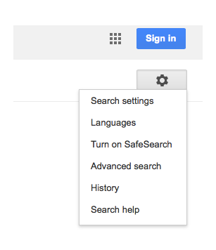
What to do?
Check history of websites children have viewed
Turn on Safe Search in Google

Slide 7
Encourage use of child friendly search engines e.g. Yahooligans
Use safe search apps on iphones and ipads e.g. K9 browser
Think about when your child needs a mobile phone. Contact the provider to put restrictions on usage.
Don’t allow your child on tablets behind closed doors.

Slide 8
Make sure you use a firewall and have anti-virus software
Set up a family email for websites children access
Encourage children to not use a nickname on sites and not share personal information

Slide 9
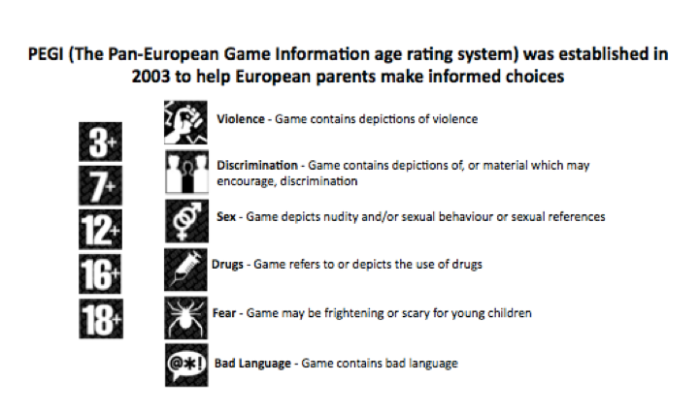
Gaming
Massively multiplayer online role playing games
Talk to children about playing with strangers and giving personal information

Slide 10
For more information…..
http://www.parentscentre.gov.uk/
www.thinkuknow.com
http://www.getnetwise.org/
http://www.childnet-int.org/
http://www.bbc.co.uk/webwise/
http://www.iwf.org.uk/
http://www.internetmatters.org/age-guides/videos.html
http://facebook.com/safety

Slide 11
Useful safe websites for links across the curriculum, including games and general resources:
http://www.bbc.co.uk/schools/parents/
http://www.topmarks.co.uk/
http://www.woodlands-junior.kent.sch.uk/Games/
http://www.bgfl.org/bgfl/15.cfm?s=15&p=251,index
http://www.bbc.co.uk/schools/
http://durham.schooljotter.com/coxhoe/Curriculum+Links

Slide 12
Children ignore age limits by opening social media accounts
Three-quarters of children aged between 10 and 12 have social media accounts despite being below the age limit, a survey has found on Safer Internet Day
A majority of 10 to 12-year-olds use social media despite being below the age limit to have an account, a survey has revealed.
Social media services like Facebook, Twitter, Instagram, Pinterest and Snapchat require account holders to be at least 13 years-old.

